Slide 1
ROAD ACCIDENT MANAGEMENT SYSTEM
Be Alert! Accident Hurts

Slide 2
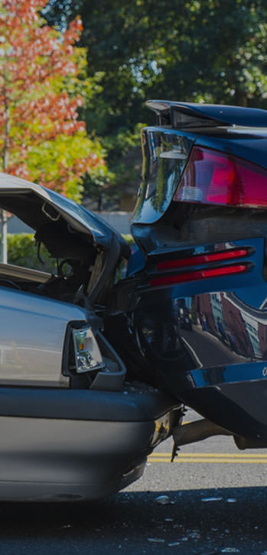
INTRODUCTION
RAMS helps us to construct a smart vehicle system with minimizing the limitations of existing methods and also enhancing the security of vehicles and human beings by reducing accidental injuries. Smart vehicle system will entail a speed and other parameters of vehicle sensing mechanism which will help drivers to prevent drunk driving, tailgating , breaking traffic signals and few more possibilities of road accidents.

Slide 3
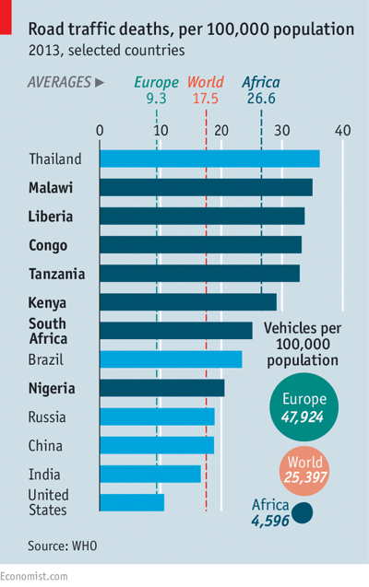
Key facts
1.3 million people die each year as a result of road traffic crashes.
The UNGA has set an ambitious target of halving the global number of deaths and injuries from road traffic crashes by 2030 (A/RES/74/299 WHO page)
Road traffic crashes cost most countries 3% of their GDP.
More than half of all road traffic deaths are among vulnerable road users: pedestrians, cyclists, and motorcyclists.
93% of the world's fatalities on the roads occur in low- and middle-income countries (like India).
Road traffic injuries are the leading cause of death for children and young adults aged 5-29 years.
According to World Health Organisation …

Slide 4


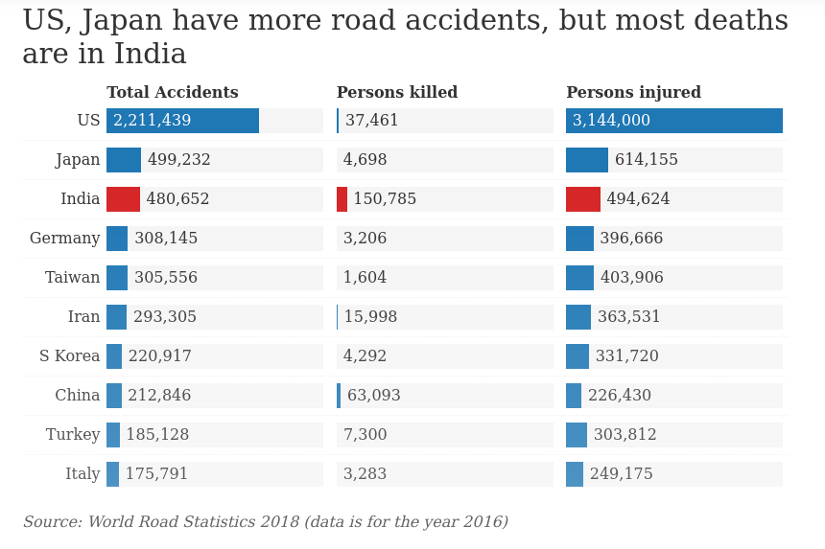

Slide 5

Accidents in India
India has been on the top of list of countries with the highest road fatalities since 2009, when the first Global Status Report on Road was published by WHO. One in every 11 road deaths globally occur on Indian roads.
India ranks 5 globally and added almost three million new cars registered in 2019 — and a road network, spanning over six million kilometers makes it one of the busiest countries in terms of road traffic.
We all know how important one’s life is and how these accidents affects people’s life physically as well as mentally. It is something which should be cared of and should be prevented , So we have proposed a model which will prevent few cases which leads to road accidents.

Slide 6
Literature Survey
The proposed system in this PPT aims at reducing the loss of lives due to traffic
accidents and performs five main tasks :
(1) Detecting the current traffic signal by training our model using the COCO dataset. YOLO V2 and SSD Mobilenet merit a special mention, in that the former achieves competitive accuracy results and is the second fastest detector, while the latter, is the fastest and the lightest model in terms of memory consumption, making it an optimal choice for deployment in mobile and embedded devices. [Alvaro Arcos-Garcıa, Juan A. Alvarez-Garcıa, Luis M. Soria-Morillo, Evaluation of Deep Neural Networks for traffic sign detection systems, Neurocomputing (2018), doi: https://doi.org/10.1016/j.neucom.2018.08.009].The evaluation and comparison of these models include mean average precision (mAP), memory allocation, running time, number of floating point operations, number of parameters of the model, and the effect of traffic sign image sizes.
(2) Identifying the proximity of nearby vehicles by object detection algorithm. It would prevent head on collision with vehicles on the highway, freeway etc. Here we are going to use MobileNet architecture, an efficient CNN architecture designed for mobile and embedded vision applications. This architecture uses proven depth-wise separable convolutions to build lightweight deep neural networks. ["Convolutional Neural Networks (MobileNet) – DeepLearning 0.1 documentation". Deep Learning 0.1. LISA Lab. Retrieved 31 August].

Slide 7
Literature Survey
(3) Monitoring driver’s drowsiness using a Computer vision system. A computer vision system that can automatically detect driver drowsiness in a real-time video stream and then play an alarm if the driver appears to be drowsy. [“The most accurate method is based on human physiological activity”,Driver Drowsiness Detection System Using Computer Vision, IRJET Volume: 07 Issue: 01 | Jan 2020 ]. Those systems shall also be designed to avoid overlap and shall not prompt the driver separately and concurrently or in a confusing manner where one action triggers both systems. This system is also known as Tiredness Detection Warning, Anti Sleep etc.
(4) Our last proposed solution would be system pothole detection system (PDS). It will use the mobility of the particular vehicle on which the system will be fitted, and side by side gather data from the vibrations and the GPS sensors, and further process and filter the data to monitor road surface condition ["A real-time pothole detection approach for intelligent transportation system", Mathematical Problems in Engineering 2015, 2015.]. A convolution neural network (CNN)-based model has been designed that takes as input images of potholes and non-pothole roads and gives results for the same. ["Pothole Detection System Using Region-Based Convolutional Neural Network," 2021 IEEE 4th International Conference on Computer and Communication Engineering Technology (CCET), 2021, pp. 6-11]

Slide 8
Literature Survey
(5) It is a natural psyche of humans to excel. But when we are sharing the road with other users we will always want to take a control. Increase in speed multiplies the risk of accident and severity of injury during accident. In our project we have used GSM/GPRS modem to locate the exact position of the vehicle. GPS is used for tracking the position of the vehicle, GSM is used for sending the message. [ “GPS beneficiary has turned into a vital piece of a vehicle. Other than utilizing as a part of different purposes, the GPS can likewise screen the speed and Distinguish a mishap” , Iot Based Automatic Accident Vehicle Location Sharing System , INTERNATIONAL JOURNAL OF SCIENTIFIC & TECHNOLOGY RESEARCH VOLUME 8, ISSUE 10, OCTOBER 2019 ISSN 2277-8616]

Slide 9

These models would help in minimizing the limitations of existing models.
Enhancing the security of vehicles and human beings by reducing accidental injuries.
These models will be useful for less memory space and gives more accurate results.
Most models of this project use the CNN for processing the images.
Gatherings from Our Survey …

Slide 10
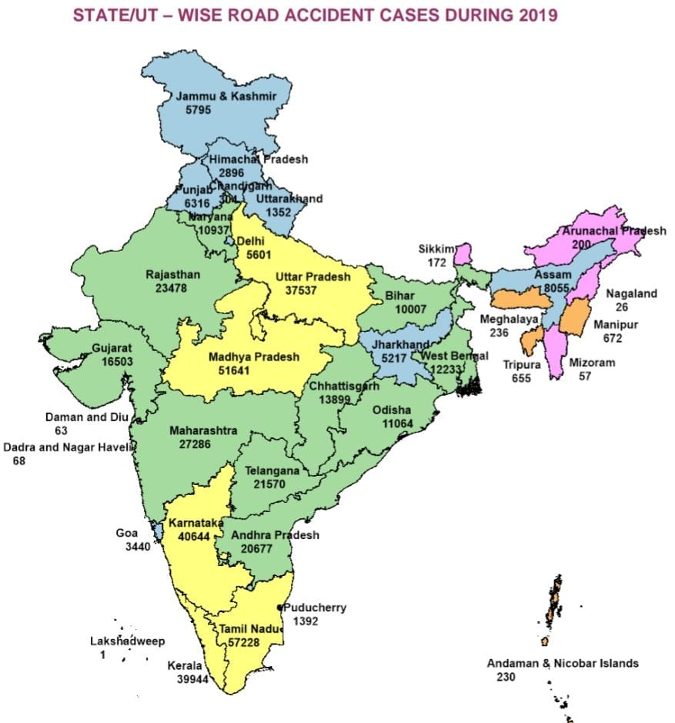
Motivation:
As cities across the world grow and the mobility of populations increases, there has also been a
corresponding increase in the
number of vehicles on roads. One of the main elements that smart
cities seek to contain is the issue of increasing levels of road accidents, which have resulted from
increasing numbers of vehicles, leading to congestion.
The motivation behind choosing this topic is drawn from this situation. We have designed
algorithms to solve this pathos using the concepts of machine learning and image processing with
maximum possible accuracy.

Slide 11
Methods Used:
This model will provide an efficient solution of few possible ways of road accidents like drowsy driver, tailgating , breaking traffic signal, falling into manholes e.t.c.
Traffic Signal Detection System
Drowsiness Detection System
Object Detection System
Pothole Detection System
Location Sharing System

Slide 12


Traffic Signal Detection System:
Traffic sign detection systems constitute a key component in trending real-world applications, such as autonomous driving, and driver safety and assistance. We aim to explore the properties of these object-detection models which are modified and specifically adapted to the traffic sign detection problem domain by means of transfer learning. In particular, various publicly available object-detection models that were pre-trained on the Microsoft COCO dataset are fine-tuned on the German Traffic Sign Detection Benchmark dataset. The evaluation and comparison of these models include key metrics, such as the mean average precision (mAP), memory allocation, running time, number of floating point operations, number of parameters of the model, and the effect of traffic sign image sizes.
Working
1. Train the model using CNN and either a custom dataset or downloaded dataset(from kaggle).
2. Make a classification as per number of signs present in the dataset.
3. Run a customized loop and validate each frame of the input video.
4. Predict the output as per classification and take appropriate decisions.

Slide 13
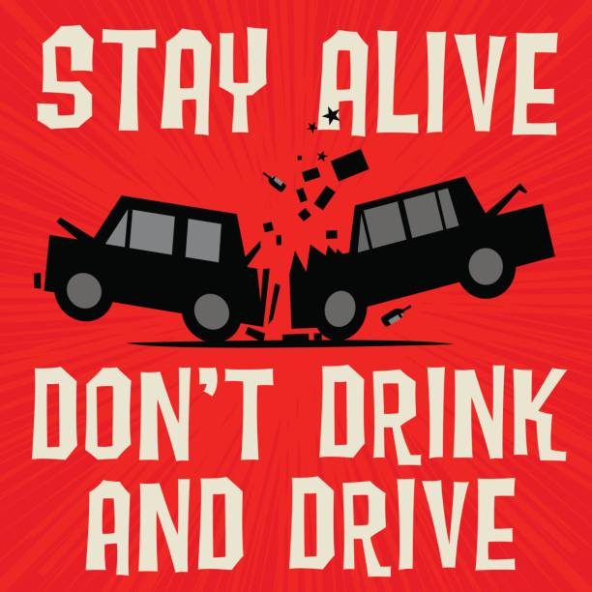
Drowsiness Detection System:
A computer vision system that can automatically detect driver drowsiness in a real-time video stream and then play an alarm if the driver appears to be drowsy.
Driver drowsiness and attention warning and advanced driver distraction warning systems shall be designed in such a way that those systems do not continuously record nor retain any data other than what is necessary in relation to the purposes for which they were collected or otherwise processed within the closed-loop system. Furthermore, those data shall not be accessible or made available to third parties at any time and shall be immediately deleted after processing. Those systems shall also be designed to avoid overlap and shall not prompt the driver separately and concurrently or in a confusing manner where one action triggers both systems.(-regulation (EU) 2019/2144) This system is also known as EyeSight
Driver Assist,Tiredness Detection Warning, Anti Sleep Pilot,Fatigue detection system etc.
Applications:
This can be used by riders who tend to drive for a longer period of time that may lead to accidents.

Slide 14
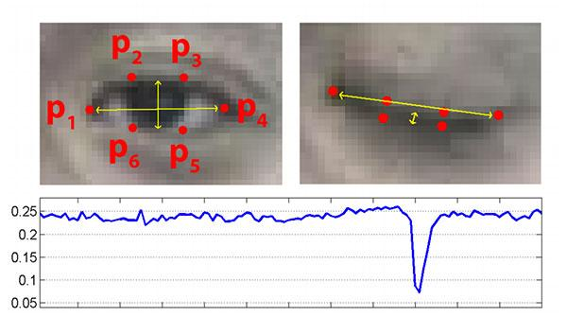
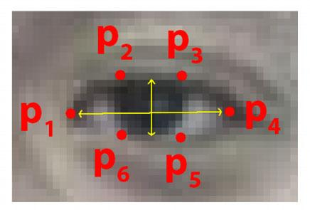
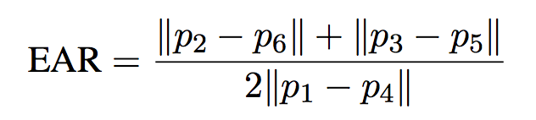
Output and Tested Images

Slide 15
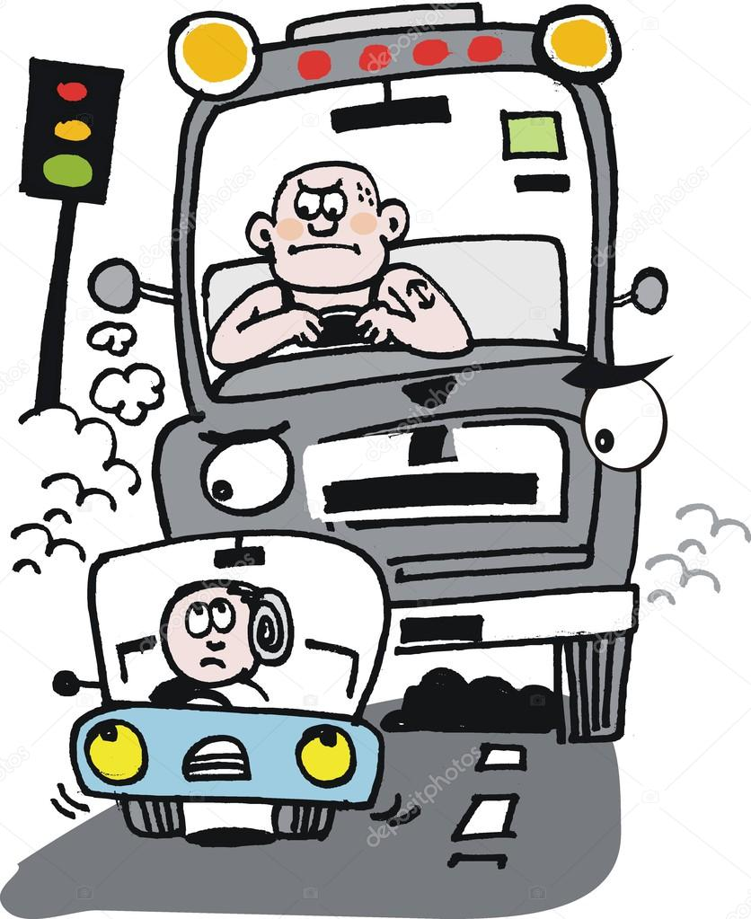
Object Detection System:
This system is used to prevent Tailgating , it detects the distance between two vehicles so as to maintain the minimum distance limit. Basically to avoid tailgating. Object detection is a branch of computer vision which deals with the localization and the identification of an object. Object localization and identification are two different tasks that are put together to achieve this singular goal of object detection.Specifying the location of an object in an image or a video stream is called object localization and assigning the object to a specific label, class, or description is called object identification. Some architectures that have performed tremendously well on the COCO dataset.
Working:
This module is a part of the Accident Control Management System. This will be helpful in detection and recognition of objects. With this, if anything comes in front of the vehicle then it will detect that and display the visuals. With the help of those visuals, the driver will be able to make a proper decision at the right time.

Slide 16
Output and Tested Images

Slide 17
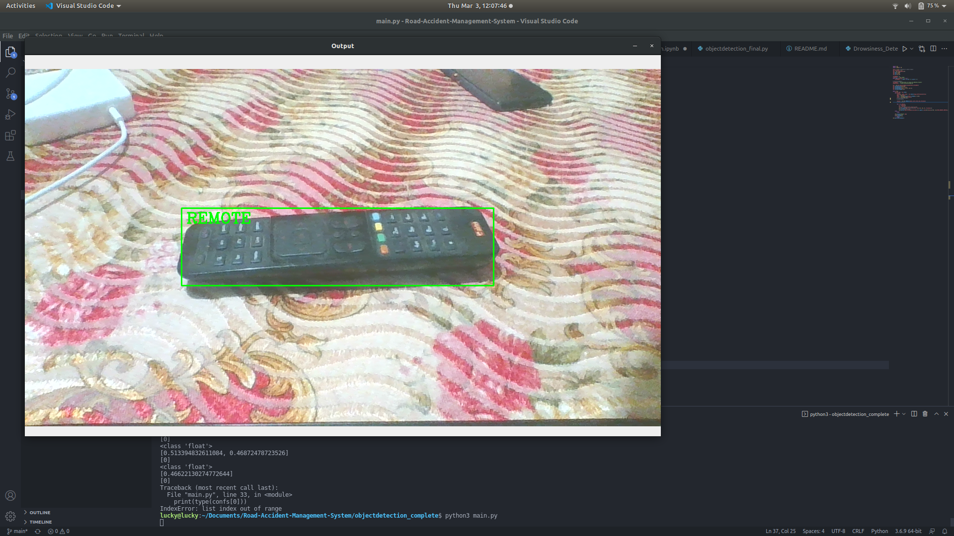
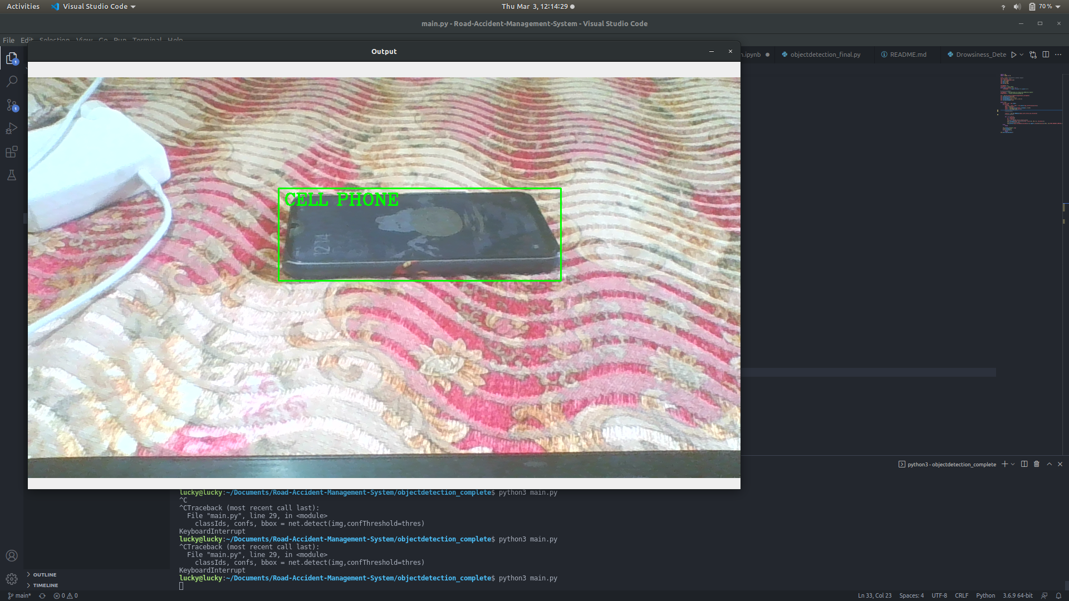
Output and Tested Images

Slide 18
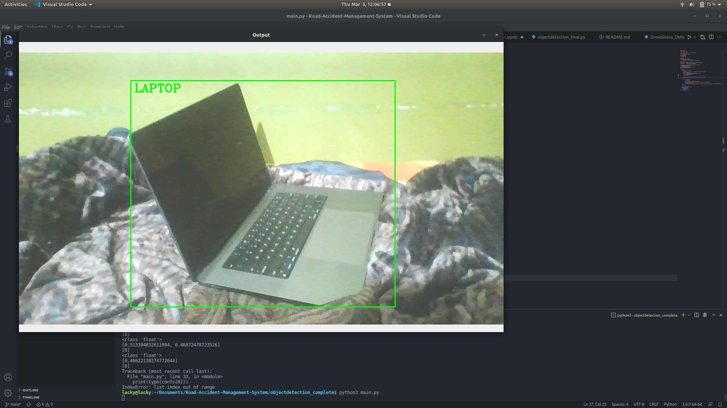
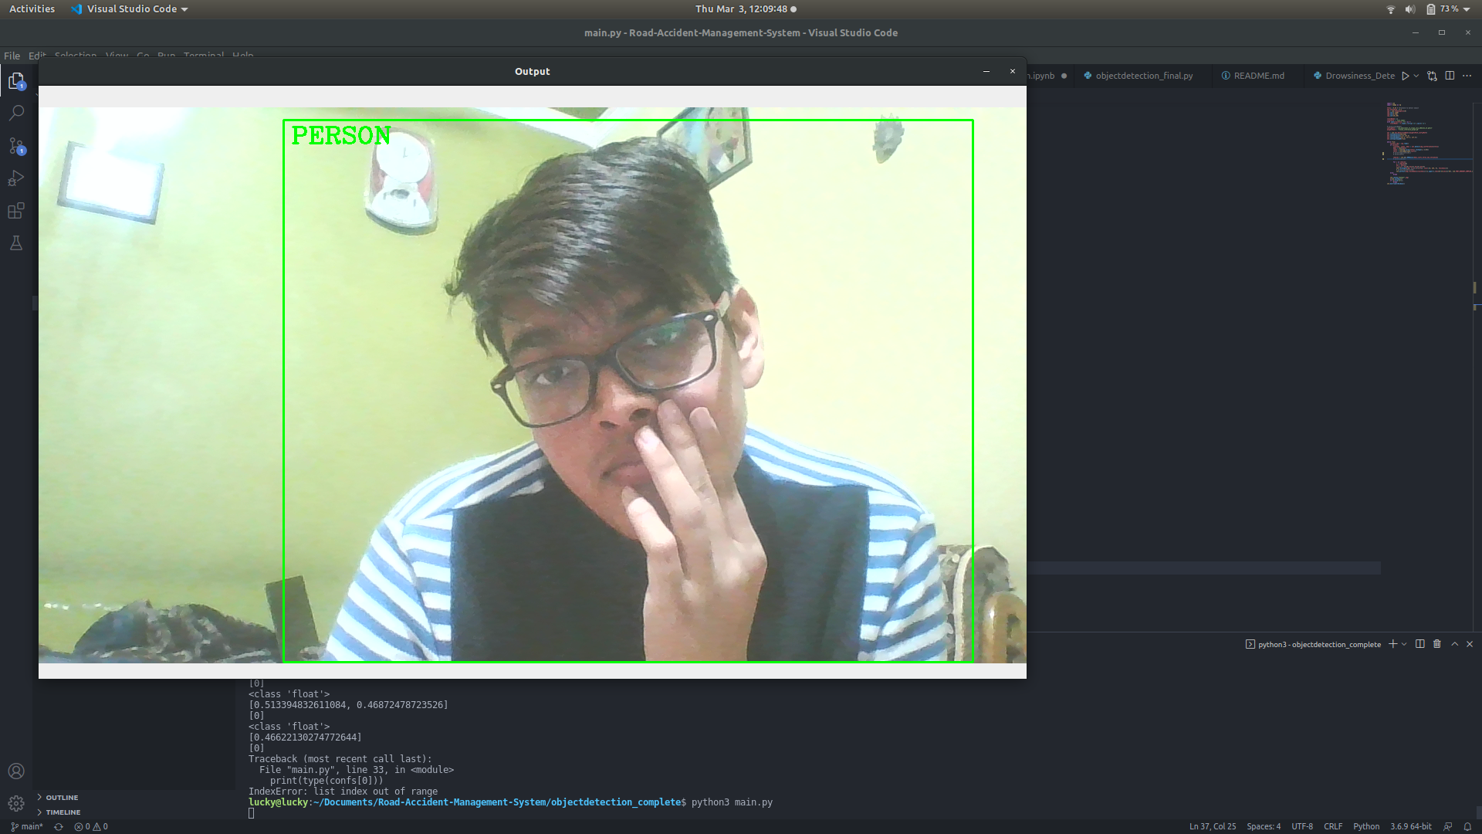
Output and Tested Images

Slide 19
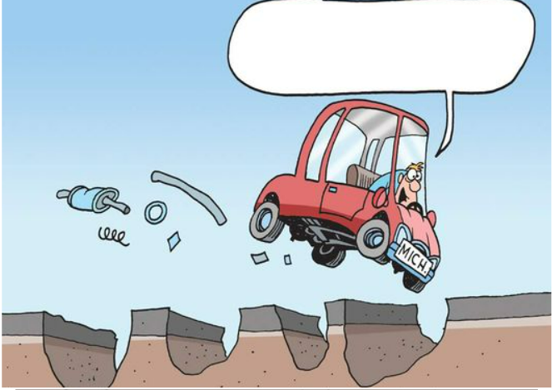
Pothole Detection System:
A pothole is a depression in a road surface, usually asphalt pavement, where traffic has removed broken pieces of the pavement. It is usually the result of water in the underlying soil structure and traffic passing over the affected area.
In India, it is one of the major causes of Road Accidents since our roads are not designed and constructed at par level thus leading to
Working :
We will classify the dataset (download from kaggle). Then, open camera so that we can detect real time pothole. This method is also applicable on images. Taking the input from camera and processed it using CNN and predict with model which is already saved. After training the model on this data, the model predicts if the input image is of a pothole or non-pothole.The output will classify into three categories that are:
1. Pot-Hole
2. Plain-Road
3. None

Slide 20
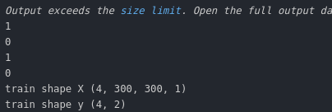
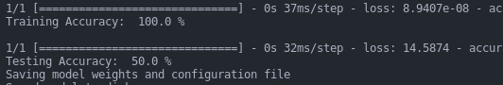
Output Images of Pothole Detection

Slide 21

Location Sharing System:
A vehicle moving on high speed will have greater impact during the crash and hence will cause more injuries. Some deaths also happen due to the lack of immediate first aid. Another problem is that the lack of information about the vehicle position. So,in our project we have used GSM/GPRS modem to locate the exact position of the vehicle.
This project presents vehicle accident detection and alert system with SMS to the user defined mobile numbers.
Working:
Socket programming is a way of connecting two nodes on a network to communicate with each other.
Now when the car suddenly meet with an accident and when it reaches above the range of sensor then the vibrating sensor will switch on and the location fetched containing longitude and latitude of the accident zone will be sent on the phone using Twilio.

Slide 22
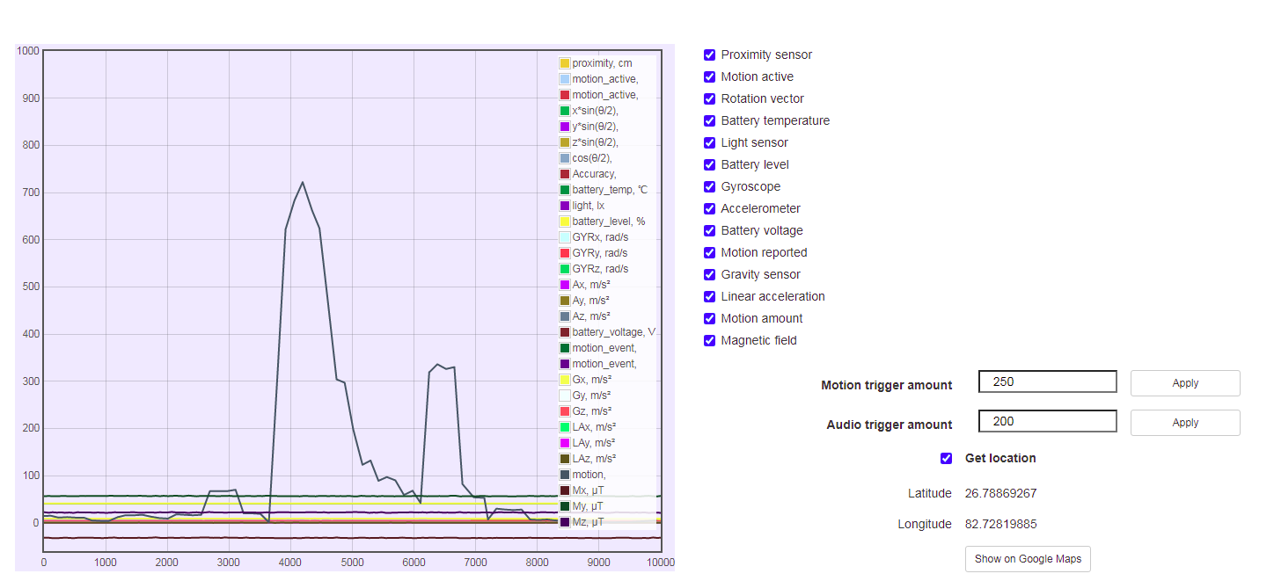
Sensor graph connected with our model

Slide 23
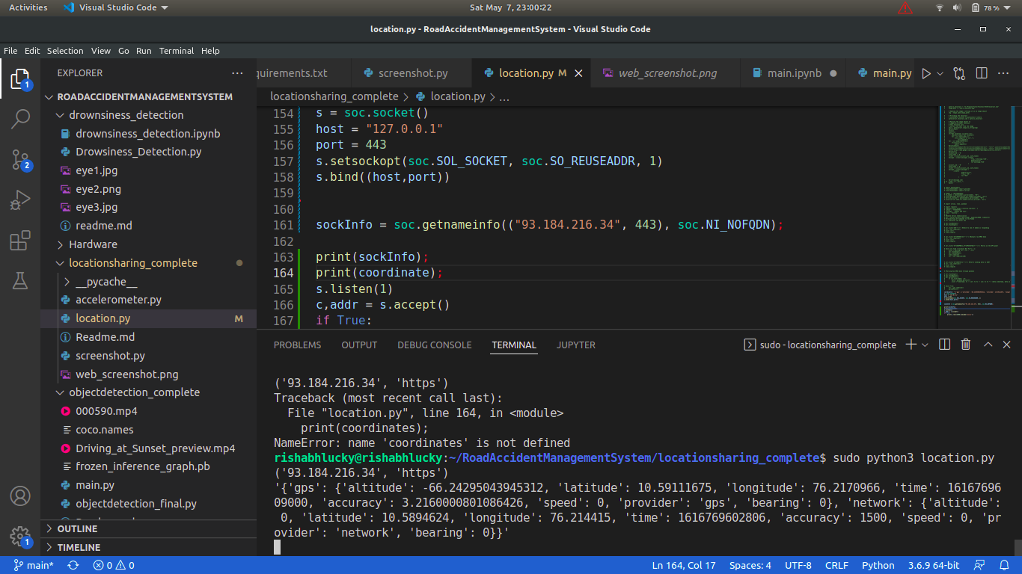

Slide 24
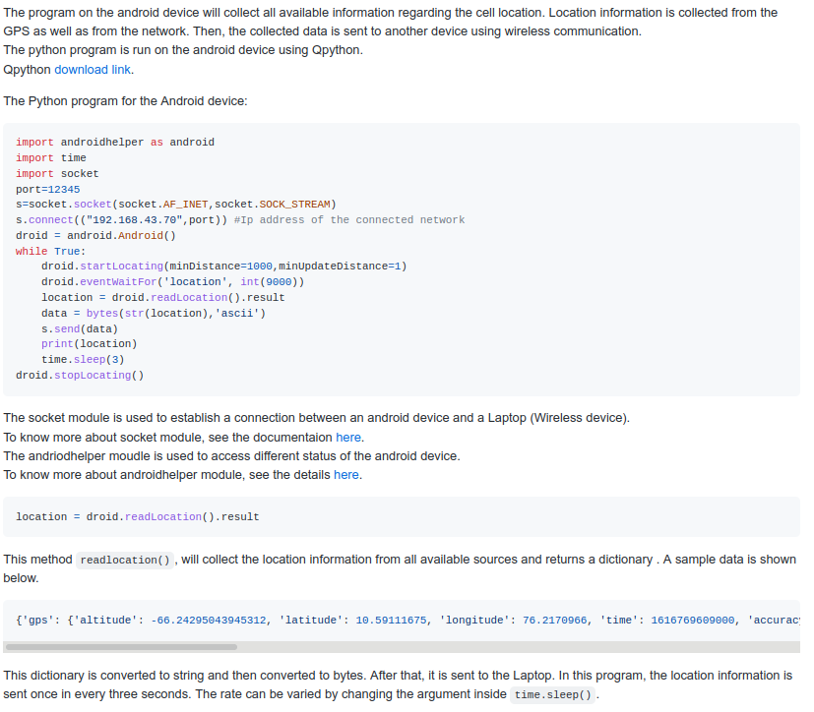
Program for Android device
Steps:
Install Qpython App.
Copy the code in the app and run it from the play button.
Make sure your Location is ON.

Slide 25

RESULT AND ANALYSIS
After using our software for more than 10 dozen datasets, we have compared the results and have
realized that it detects the moving object and it can help us track the movement of the object in
front of the driving car which can detect and warn the driver to stop tailgating and maintain proper
distance. However it might miss a few objects which are not moving and which are too small to be
noticed, but our model will keep updating and will learn with time.
We have analyzed that our model works 8/10 times correctly, that means it detected the object
correctly in every 8 datasets for every 10 datasets which were differently presented but having the
same kind of object which gives us the accuracy of 80-85%. This was the average calculated after
running our models a few times and now we can conclude that this model is ready for use in public
and can help to detect the objects in front of the vehicle so as to prevent tailgating. We have
attached a few screenshots and recorded a few object movements in the next chapter so as to
show the working of our model.
A object detection model produces the output in three components:
● The bounding boxes — x1, y1, width, height if using the COCO file format
● The class of the bounding box
● The probability score for that prediction— how certain the model is that the class is actually
the predicted class

Slide 26
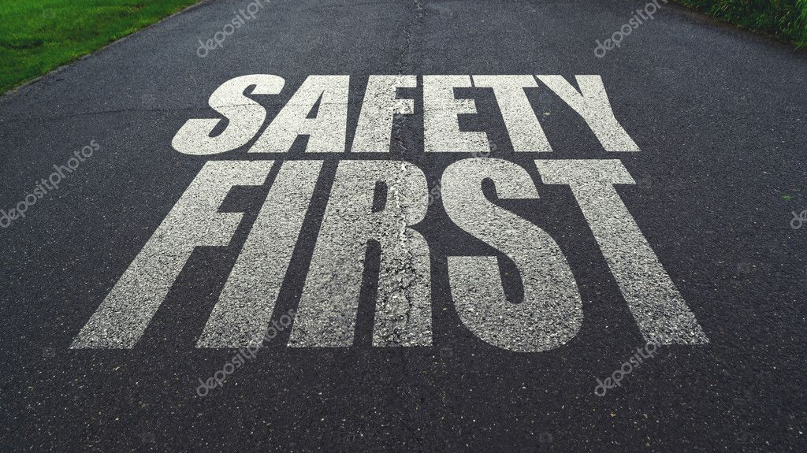
CONCLUSION
The main aim of this system is to construct a smart vehicle system with minimizing the limitations of existing models and also enhancing the security of vehicles and human beings by reducing accidental injuries. Smart vehicle system will entail a speed and other parameters of vehicle sensing mechanism which automatically messages to personal contacts with the details of vehicle position when an accident occurs using the GPS system. By using image processing technology we can produce an accident free environment. This model will be useful for less memory space and gives more accurate results. Most models of this project use CNN for processing the images.

Slide 27
FUTURE SCOPE
In the future work, the model can be extended to:
Lane Detection :
Extend the idea of deep learning in detecting the lanes by developing a multi-task deep CNN. Some of the filters which can be used are bilateral filter, gaussian filter, trilateral filter. One can change the current Hough Transformation so that it can sum up curved and straight roads respectively.
Autopilot :
This system will generate an angle for steering control and the generation of angles basically depends on the movement of the camera.For more accurate results calibration of the camera is required. The camera is fixed into a particular angle and the learning rate of the model will increase and also provides an effective output.
Plate detection :
Plate number detection is a combination of two parts that are
plate-number-recognition and plate-number-detection. Apart from that it also uses text extraction for
saving the plate-number in a csv file.

Slide 28

REFERENCES
[1] Andrew G. Howard, Menglong Zhu, Bo Chen, Dmitry Kalenichenko, Weijun Wang, Marco Andreetto, Tobias Weyand, Hartwig Adam, Efficient Convolutional Neural Networks for Mobile Vision Applications (MobileNet-architecture)
[2] Alvaro Arcos-Garcıa, Juan A. Alvarez-Garcıa, Luis M. Soria-Morillo, Evaluation of Deep Neural Networks for traffic sign detection systems, Neurocomputing (2018), doi: https://doi.org/10.1016/j.neucom.2018.08.009
[3] “The most accurate method is based on human physiological activity”, Aditya Ranjan, Karan Vyas, Sujay Ghadge, Siddharth Patel, Suvarna Sanjay Pawar , Driver Drowsiness Detection System Using Computer Vision, IRJET Volume: 07 Issue: 01 | Jan 2020.
[4] Jiali Cui, Fuqiang Chen, Duo Shi, Liqiang Liu, 2019, Eye Detection with Faster R-CNN, In Proceedings of the International Conference on Advances in Computer Technology, Information Science and Communications (CTISC 2019), DOI: 10.5220/0008096201110116, ISBN: 978-989-758-357-5.

Slide 29
REFERENCES
[5] Naethan Jacob, Dr. Vishalakshi Prabhu H, 2020, Comparative Review of YOLO & MobileNet Versions: A Case Study, (IRJET), ISSN: 2395-0056, Volume: 07 Issue: 04 | Apr 2020.
[6] Pothole Detection System Using Region-Based Convolutional Neural Network," 2021, IEEE 4th International Conference on Computer and Communication Engineering Technology (CCET), pp. 6-11, doi: 10.1109/CCET52649.
[7] Nathan Jennings, Socket Programming in Python (Guide), Feb 21, 2022.
[8] Tejal Palwankar, Kushal Kothari, 2022, Real Time Object Detection using SSD and MobileNet, International Journal for Research in Applied Science & Engineering Technology (IJRASET), ISSN: 2278-0181, Volume 10 Issue III Mar 2022.

Slide 30

Thank You
Submitted by :-
Kushagra Upadhyay (2018UGCS020R)
Rishabh Kumar (2018UGCS042R)
Neha Kumari (2018UGCS056R)

